Slide 1

GlobalPlacements
Samutthãna Global Placements offer a unique opportunity to those contemplating careers in health, mental health, social work, psychology, counselling and therapy. The packed programme not only offers experiential and educational workshops, opportunity to observe and interact with residents in care settings but also experience the wonder and beauty of Sri Lanka.
Samutthãna with links to King’s College London (www.samuthana.org) was established over 20 years ago following the Asian Tsunami as a resource centre to build capacity to deal with the mental health consequences and of the tragedy. Its parent body, the UK-Sri Lanka Trauma Group (www.uksrilankatrauma.org) a UK registered charity was established 1996, to help Sri Lanka deal with the mental health consequences of the civil war in the country at the time. Both organisations are well connected with the mental health services in Sri Lanka and UK. Among the many achievements of the two organisations are establishing the first clinical psychology training course in Sri Lanka at the University of Colombo, having over 55,000 attendances at it workshops and providing placements in Sri Lanka for UK clinical psychology doctoral students.
Health and wellbein | Culture and Mental Health | Capacity building work of Samutthãna and UK-SLTG
Basic counselling skills – helping relationships | Basic communication skills in counselling | Introduction to CBT
Psychological First Aid Option 1 | Meditation and mindfulness-based approaches Option 2 | Basic CBT for Anxiety Disorders Option 3

Slide 2
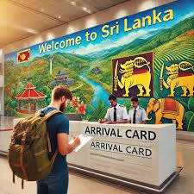
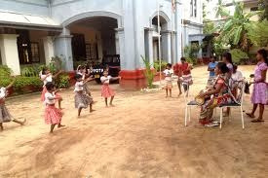
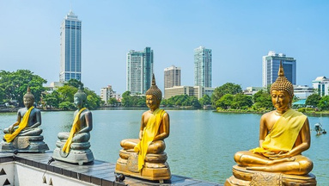
GlobalPlacements
ITINERARY
Destination : Sri Lanka
Duration : 03 Weeks
WEEK 1
ARRIVAL IN SRI LANKA
Transfer to Accommodation Day at Leisure
SAMUTTHANA
Orientation session at Samutthana Lunch
Session on mental health and well- being
Working with staff members
Lunch
Working with the children in Care
LANKADHARA CARE HOME
CULTURAL TOUR
Visit to a Buddhist Temple / Hindu Kovil / Catholic church / Mosque
SAMUTTHANA
Workshop on Culture and Mental Health
Lunch
Group discussion – Capacity building work of Samutthana
DAY AT LEISURE
REST DAY

Slide 3
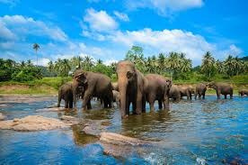
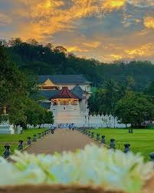
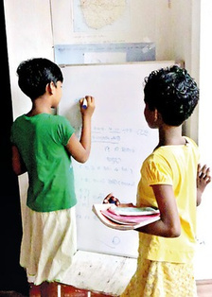
GlobalPlacements
ITINERARY
Destination : Sri Lanka
Duration : 03 Weeks
WEEK 2
MJF FOUNDATION
Full day at the school for children with special needs
Basic Counselling Skills
SAMUTTHANA
Lunch
Basic CBT
SHOPPING / SIGHTSEEING
Exploring the city of Colombo at Leisure
DEPART TO KANDY
En route :
Visit to the elephant orphanage
Lunch
Visit to Saradiyel’s village to
KANDY GENERAL HOSPITAL
CHILD ACTION LANKA
experience ancient rural village life
Full day visit and volunteer work
Full day visit and volunteer work
DEPART TO GALLE
En route :
Visit to the temple of the tooth relic Peradeniya Botanical gardens

Slide 4
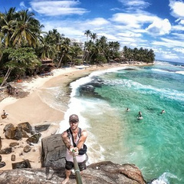
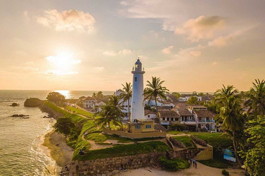
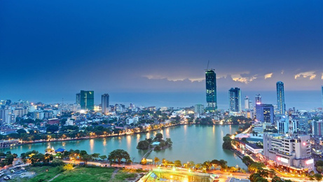
GlobalPlacements
ITINERARY
Destination : Sri Lanka
Duration : 03 Weeks
WEEK 3
EXPLORE THE CITY OF GALLE
ENJOY SOME SUN, SEA AND SAND
RETURN TO COLOMBO
En route :
Visit the turtle hatchery.
NATIONAL INSTITUTE OF MENTAL HEALTH
Visit to the NIMH
Lunch
Wrap discussion with the Samutthãna team.
FAREWELL
Reflective presentation Farewell Dinner
DAY AT LEISURE
DEPART TO THE AIRPORT

